Slide 1

Bharath Rooms and Services​
​
Guest Guru Team​
K Saketh Ram​
N Surya Teja​
O Bharath​
​

Slide 2
Room Structure: Blueprint of a Hotel Room
1
roomNumber
2
isBooked
3
guestName
Unique identifier for each room (e.g., 101, 202).
Status of the room: 0 for available, 1 for booked.
Name of the guest occupying the room (max 50 chars).
4
Rent
5
paid
Daily rent of the room represented by an integer value.
Amount paid by the guest, tracking payments made.

Slide 3
Hotel Structure: Managing Multiple Rooms
rooms[MAX_ROOMS]
totalRooms
Array of Room structures to manage rooms.
Total number of rooms in the hotel.
The Hotel structure uses a fixed-size array to hold room data for the entire hotel. For example, MAX_ROOMS = 100 means the hotel can manage 100 rooms.

Slide 4



Data Structure Relationships
Hotel
Building
Rooms
Individual Rooms
The Hotel structure uses the Room structure to manage its rooms. Accessing room 50's rent can be done using hotel.rooms.Rent.

Slide 5

Core Operations Enabled
Booking a Room
Update isBooked to 1 and store guestName.
Checking Out
Reset isBooked to 0, clear guestName.
Generating Reports
List available rooms, occupancy rate, and revenue.
Room Payment
Update paid with amount and store.

Slide 6




Benefits of Data Structure Design
Efficient Room Management
1
Scalability
2
4
Simplified Operations
3
Data Integrity
This design allows fast access to room data and easy management of a large number of rooms. It also ensures consistent and reliable data storage. Calculating total revenue becomes simple.

Slide 7
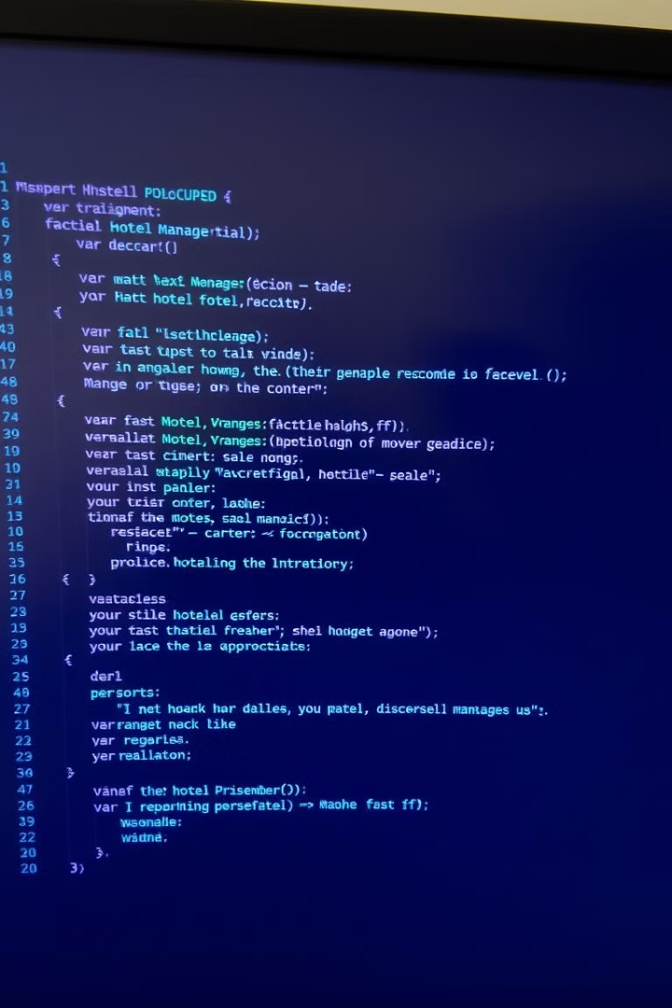
Code Example: Booking a Room
Simplified C code snippet for booking a room:
struct Room room; room.isBooked = 1; strcpy(room.guestName, "John Doe");
This demonstrates how isBooked and guestName are updated. Error handling checks if the room is already booked.

Slide 8

Conclusion: Efficient Hotel Management
The Room and Hotel structures provide a solid foundation for efficient hotel management. Choosing the right data structures is essential for specific tasks. Future enhancements may include search, sorting, and dynamic memory allocation.

